Slide 1



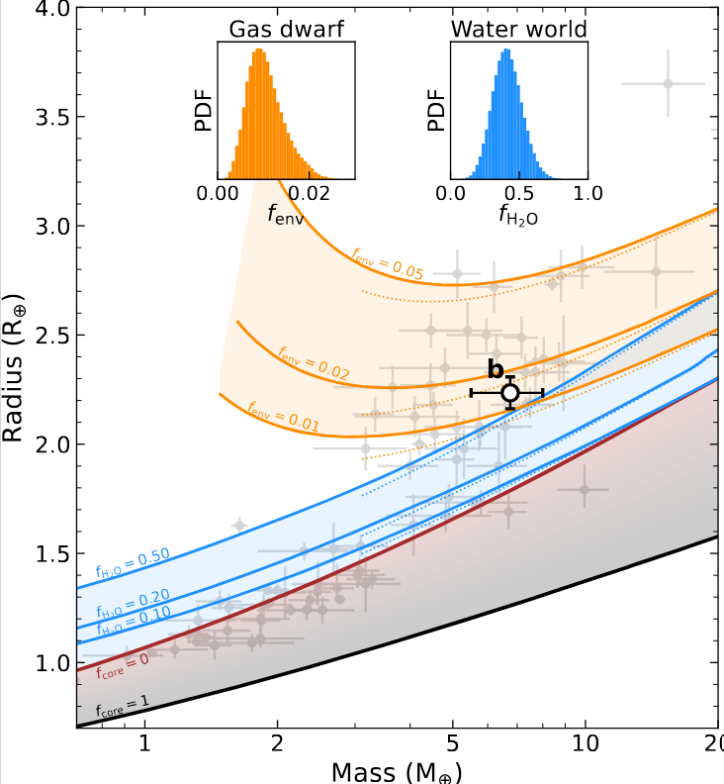
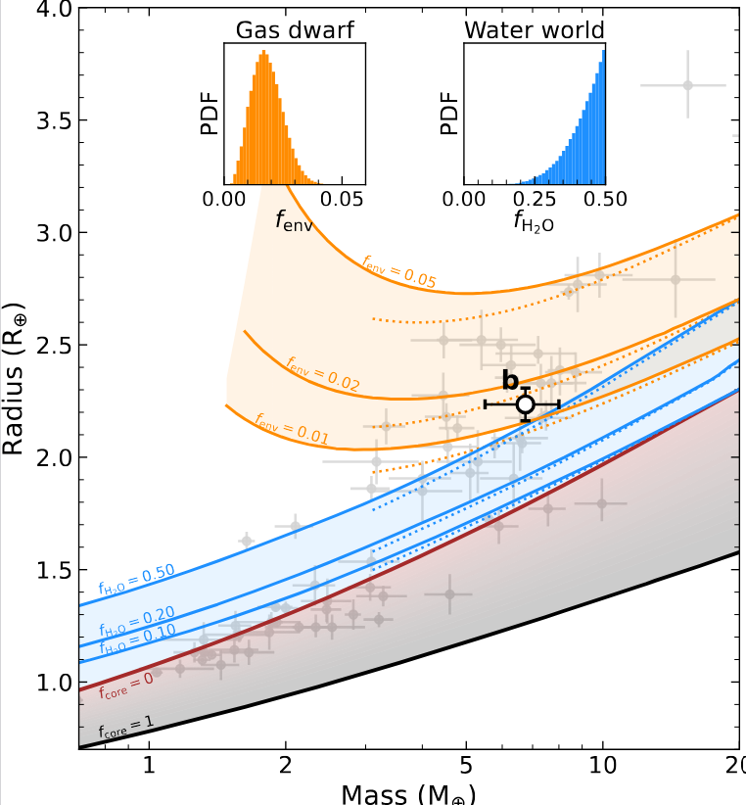
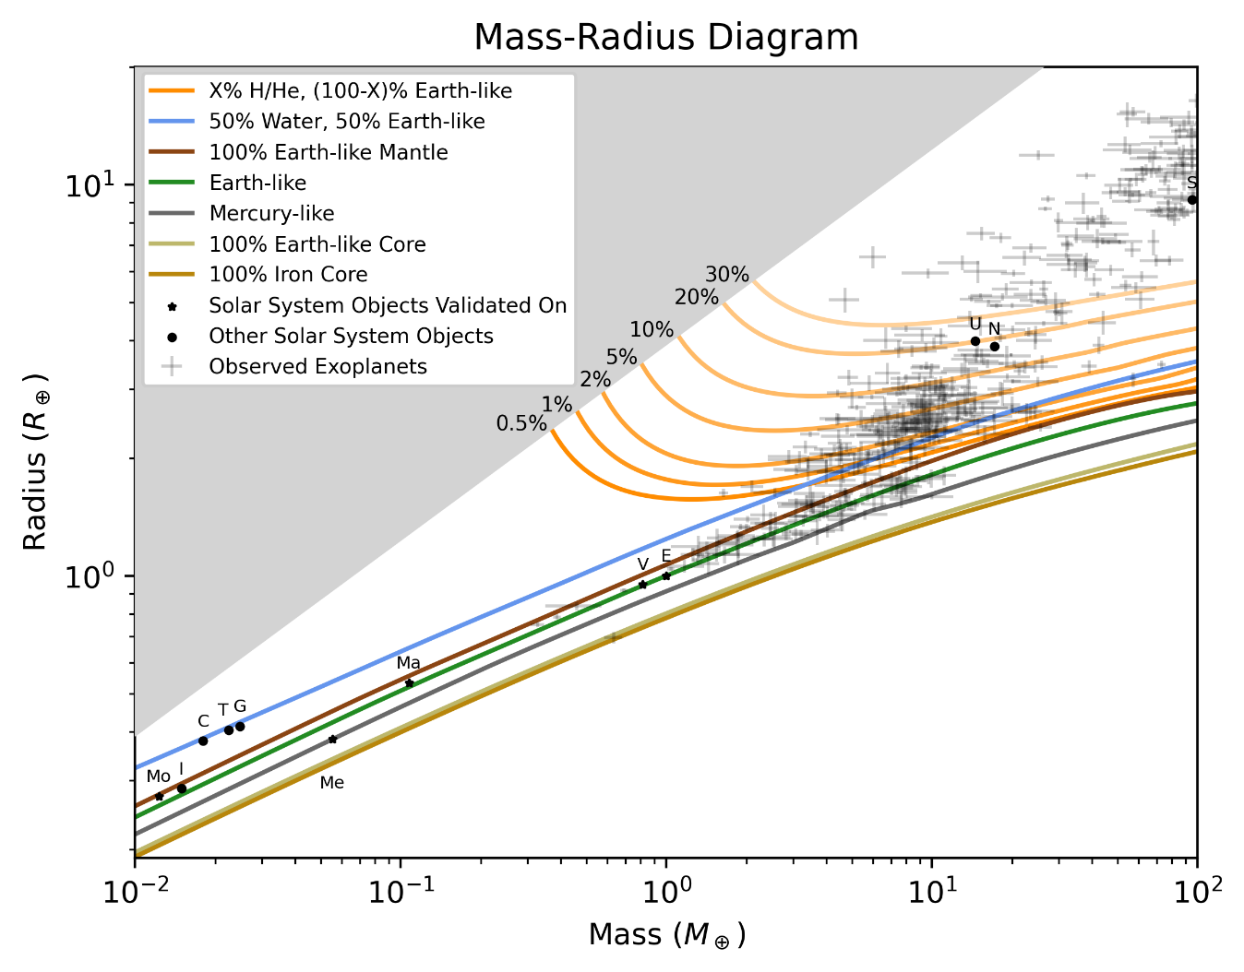
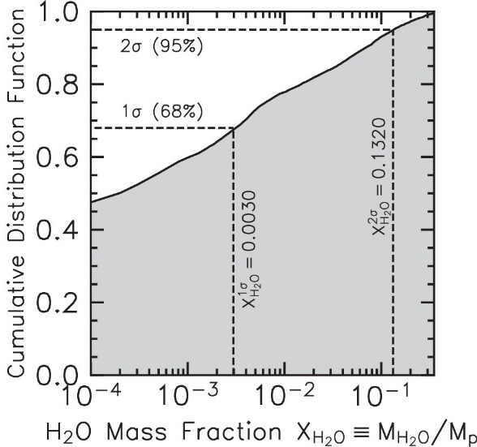
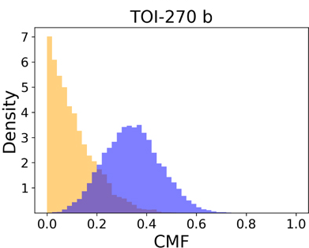
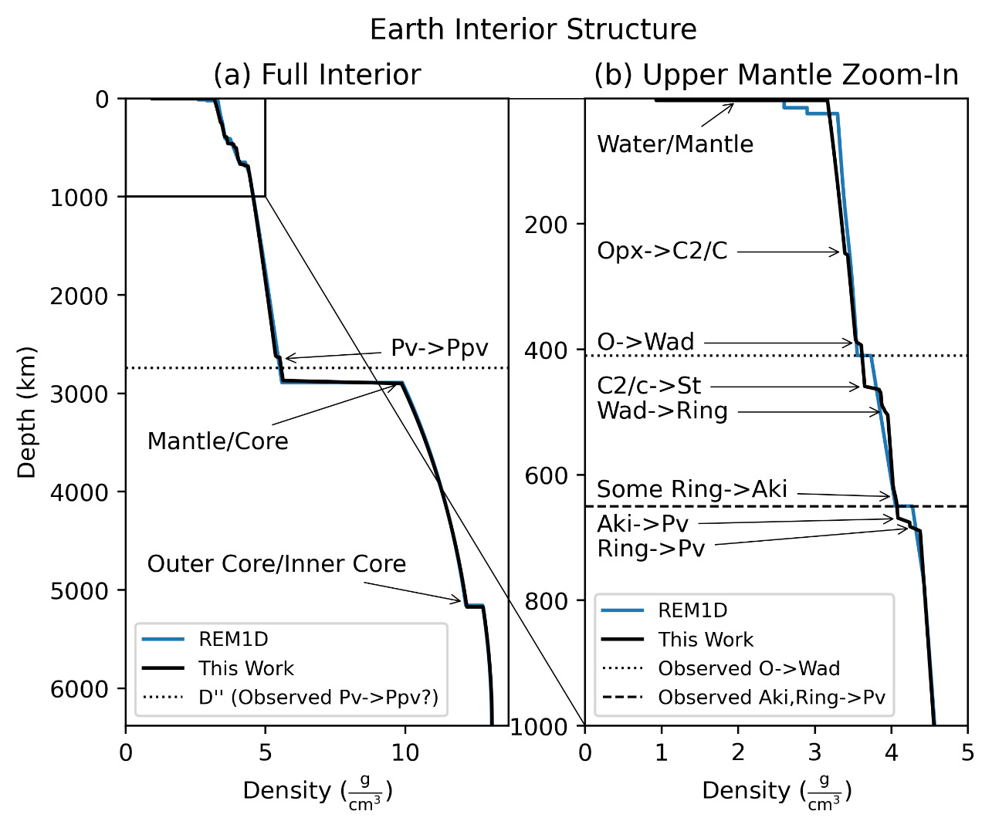
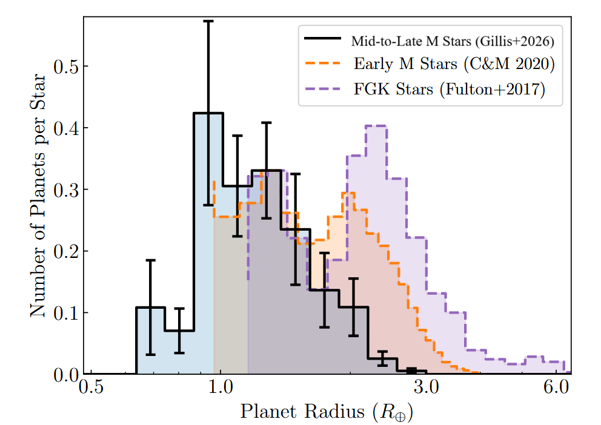

Read the paper in press!
https://arxiv.org/abs/2604.15304
Inferring Planet Compositions Using Statistical Methods
Bennett Neil Skinner, Ralph Pudritz, and Ryan Cloutier
skinnb1@mcmaster.ca
Background
A New Forward Model
Applying the New Model
Observations give planetary masses (M), radii (R), and equilibrium temperatures (T)
But to compare to theory, need compositions, which must be inferred from observed parameters using an Interior Structure Model that gives R(M, composition)¹
Convert R(M, T, Composition) -> Composition(M, R, T)
Highly degenerate—over a dozen free composition parameters constrained by just 3
We have created the most comprehensive interior structure model in the literature¹
Previous models⁷⁻¹⁸ have systematic biases in model radii -> literature inferred compositions biased
Bias comparable to observational errors¹⁹, PLATO²⁰ will bring average observational errors further down
New model uses most up-to-date Equations of State
H/He: Non-ideal mixing, new simulation results²¹⁻²³
Water: 12+ phases, high P simulations²⁴
Mantle: Mixing, melting, high P phases²⁵⁻³²
Core: Light element, better high P extrapolation³³⁻³⁷
Additional corrections: Radiative transfer³⁸⁻³⁹, internal luminosity⁴⁰, transit geometry⁴¹, rotation⁴²⁻⁴³
Extremely high accuracy solar system replication^{1,44-45}
Net effect: Cold planets denser, hot planets less dense
M-R Curves: https://zenodo.org/records/20382153
Incorporated into SMINT framework⁴³⁻⁴⁴
Linearly interpolates R from M-composition grid
Runs MCMC to retrieve planets’ composition
First application to TOI-210 b makes water-rich composition less likely when compared to H/He-rich⁴⁴
Application to more individual targets forthcoming – email w/ requests to generate grids for specific objects
The Need For Compositions
Inferred H/He % increased
-> H/He scenario remains realistic
Planet radii are bimodal around FGK stars, with smaller super-Earths and larger sub-Neptunes²⁻⁴
Two possible differentiating mechanisms: atmospheric mass loss⁵ (sub-Neptunes are H/He-enhanced) or water-rich formation⁶ (sub-Neptunes are water-enriched)
Sub-Neptunes less prominent around lower-mass stars²⁻⁴ -> Finding their composition reveals planet formation around most common type of star
Sub-Neptunes around M Dwarfs can be closer in -> would have lost atmosphere -> could be water-rich³
If water-rich -> widespread planet migration⁶
Inferred H₂O % increased
-> H₂O scenario less realistic
(Need more water than plausible)
Reproduced from Cadieux, Skinner, et al. (In Prep.) Fig. 7 (left previous version, right current)
Recent Literature Advances
Reproduced from Skinner, Pudritz, & Cloutier (2026) Fig. 8
FGK Super-Earths -> Earth-like⁴⁵⁻⁴⁷
M Dwarf Super-Earths -> Water-rich interiors?⁴⁸
Super-Earth
Sub-Neptune
Planet’s inferred core mass from M,R lower than if abundances from star -> core polluted by light element
Has lost atmosphere
Has retained atmosphere
Planet’s M,R -> light core
Star’s [Fe/Mg] -> Earth-like
Atmospheric Mass Loss
Water-Rich Formation
Formed mostly inside iceline
Formed mostly outside iceline
Reproduced from Skinner, Pudritz, & Cloutier (2026) Fig. 4
Reproduced from Rogers et al. (2025) Figure 5
Reproduced from
Weisserman et al. (2026) Figure 7
Future Work
Integrate our state-of-the-art forward model into a robust statistical model, run on a large population
Investigate FGK v. M Dwarf super-Earth dichotomy
Conduct first comprehensive sub-Neptune inference
Possible widely-used methods each w/ downsides⁴⁹⁻⁵¹:
Interpolation – Inaccurate b/c not directly calculating
MCMC – computationally intensive (~10 cpu-d/planet)
Machine learning – Long training makes updates hard
We are in the beginning stages of implementing statistical methods – feedback very welcome!
Smaller Hosts
References
Scan for poster copy & references
1. Skinner, Bennett Neil, Ralph E. Pudritz, and Ryan Cloutier (Apr. 2026). “A Validated Low-to-Intermediate Mass Planetary Interior Structure Model and New Mass-Radius Relations”. In Press. In: arXiv e-prints, arXiv:2604.15304, arXiv:2604.15304. doi: 10.48550/arXiv.2604.15304. arXiv: 2604.15304 [astro-ph.EP]. 2. Fulton, Benjamin J. et al. (Sept. 2017). “The California-Kepler Survey. III. A Gap in the Radius Distribution of Small Planets”. In: 154.3, 109, p. 109. doi: 10.3847/1538-3881/aa80eb. arXiv: 1703.10375 [astro-ph.EP]. 3. Cloutier, Ryan and Kristen Menou (May 2020). “Evolution of the Radius Valley around Low-mass Stars from Kepler and K2”. In: 159.5, 211, p. 211. doi: 10.3847/1538-3881/ab8237. arXiv: 1912.02170 [astro-ph.EP].
4. Gillis, Erik Diego, Ryan Cloutier, and Emily K. Pass (May 2026). “TESS Planet Occurrence Rates Reveal the Disappearance of the Radius Valley around Mid-to-late M Dwarfs”. In: 171.5, 317, p. 317. doi: 10.3847/1538- 3881/ae5810. arXiv: 2602.23364 [astro-ph.EP].
5. Owen, James E. and Yanqin Wu (Oct. 2013). “Kepler Planets: A Tale of Evaporation”. In: 775.2, 105, p. 105. doi: 10.1088/0004-637X/775/2/105. arXiv:1303.3899 [astro-ph.EP].
6. Venturini, J. et al. (June 2024). “A fading radius valley towards M dwarfs, a persistent density valley across stellar types”. In: 686, L9, p. L9. doi: 10.1051/0004-6361/202349088. arXiv: 2404.01967 [astro-ph.EP]. 7. Haldemann, Jonas et al. (Jan. 2024). “BICEPS: An improved characterization model for low- and intermediate-mass exoplanets”. In: 681, A96, A96. doi: 10.1051/0004-6361/202346965.
8. Huang, Chenliang, David R. Rice, and Jason H. Steffen (July 2022). “MAGRATHEA: an open-source spherical symmetric planet interior structure code”. In: 513.4, pp. 5256–5269. doi: 10 . 1093 / mnras / stac1133. arXiv: 2201.03094 [astro-ph.EP].
9. Plotnykov, Mykhaylo and Diana Valencia (Nov. 2020). “Chemical fingerprints of formation in rocky super-Earths’ data”. In: 499.1, pp. 932–947. doi: 10. 1093/mnras/staa2615. arXiv: 2010.06480 [astro-ph.EP].
10. — (May 2024). “Observation uncertainty effects on the precision of interior planetary parameters”. In: 530.3, pp. 3488–3499. doi: 10.1093/mnras/stae993. arXiv: 2405.03860 [astro-ph.EP].
11. Rice, David R. et al. (June 2025). “Uncertainties in the Inference of Internal Structure: The Case of TRAPPIST-1 f”. In: 986.1, 2, p. 2. doi: 10.3847/1538-4357/add34b. arXiv: 2504.16201 [astro-ph.EP].
12. Seager, S. et al. (Nov. 2007). “Mass-Radius Relationships for Solid Exoplanets”. In: 669.2, pp. 1279–1297. doi: 10 . 1086 / 521346. arXiv: 0707 . 2895 [astro-ph].
13. Sotin, C., O. Grasset, and A. Mocquet (Nov. 2007). “Mass radius curve for extrasolar Earth-like planets and ocean planets”. In: 191.1, pp. 337–351. doi: 10.1016/j.icarus.2007.04.006.
14. Unterborn, C. T. et al. (Feb. 2023). “The Nominal Ranges of Rocky Planet Masses, Radii, Surface Gravities, and Bulk Densities”. In: 944.1, 42, p. 42. doi: 10.3847/1538-4357/acaa3b. arXiv: 2212.03934 [astro-ph.EP].
15. Valencia, Diana, Dimitar D. Sasselov, and Richard J. O’Connell (Aug. 2007). “Detailed Models of Super-Earths: How Well Can We Infer Bulk Properties?” In: 665.2, pp. 1413–1420. doi: 10.1086/519554. arXiv: 0704.3454 [astro-ph].
16. Zeng, Li, Stein B. Jacobsen, et al. (May 2019). “Growth model interpretation of planet size distribution”. In: Proceedings of the National Academy of Science 116.20, pp. 9723–9728. doi: 10.1073/pnas.1812905116. arXiv: 1906.04253 [astro-ph.EP].
17. Zeng, Li and Dimitar Sasselov (Mar. 2013). “A Detailed Model Grid for Solid Planets from 0.1 through 100 Earth Masses”. In: 125.925, p. 227. doi: 10.1086/669163. arXiv: 1301.0818 [astro-ph.EP].
18. Zeng, Li, Dimitar D. Sasselov, and Stein B. Jacobsen (Mar. 2016). “Mass-Radius Relation for Rocky Planets Based on PREM”. In: 819.2, 127, p. 127. doi: 10.3847/0004-637X/819/2/127. arXiv: 1512.08827 [astro-ph.EP]. 19. Christiansen, J. L. et al. (Aug. 2025). “The NASA Exoplanet Archive and Exoplanet Follow-up Observing Program: Data, Tools, and Usage”. In: 6.8, 186, p. 186. doi: 10.3847/PSJ/ade3c2. arXiv: 2506.03299 [astro-ph.EP].
20. Rauer, Heike et al. (June 2025). “The PLATO mission”. In: Experimental Astronomy 59.3, 26, p. 26. doi: 10 . 1007 / s10686 - 025 - 09985 - 9. arXiv:2406.05447 [astro-ph.IM]. 21. Chabrier, G., S. Mazevet, and F. Soubiran (Feb. 2019). “A New Equation of State for Dense Hydrogen-Helium Mixtures”. In: 872.1, 51, p. 51. doi: 10. 3847/1538-4357/aaf99f. arXiv: 1902.01852 [astro-ph.SR].
22. Chabrier, Gilles and Florian Debras (Aug. 2021). “A New Equation of State for Dense Hydrogen-Helium Mixtures. II. Taking into Account Hydrogen-Helium Interactions”. In: 917.1, 4, p. 4. doi: 10.3847/1538-4357/abfc48. arXiv: 2107.04434 [astro-ph.SR].
23. Howard, S. and T. Guillot (Apr. 2023). “Accounting for non-ideal mixing effects in the hydrogen-helium equation of state”. In: 672, L1, p. L1. doi: 10.1051/0004-6361/202244851. arXiv: 2302.07902 [astro-ph.EP].
24. Haldemann, Jonas, Yann Alibert, et al. (Nov. 2020). “AQUA: a collection of H2O equations of state for planetary models”. In: 643, A105, A105. doi: 0.1051/0004-6361/202038367. arXiv: 2009.10098 [astro-ph.EP].
25. Dong, J. et al. (Apr. 2025). “Structure and Melting of Fe, MgO, SiO2, and MgSiO3 in Planets: Database, Inversion, and Phase Diagram”. In: 6.4, 103, p. 103. doi: 10.3847/PSJ/adc717. arXiv: 2503.21734 [astro-ph.EP].
26. Greenberg, E. et al. (June 2023). “Phase transitions and spin state of iron in FeO under the conditions of Earth’s deep interior”. In: 107.24, L241103, p. L241103. doi: 10 . 1103 / PhysRevB . 107 . L241103. arXiv: 2004 . 00652 [cond-mat.str-el].
27. Musella, R., S. Mazevet, and F. Guyot (Feb. 2019). “Physical properties of MgO at deep planetary conditions”. In: 99.6, 064110, p. 064110. doi: 10.1103/PhysRevB.99.064110. arXiv: 1805.12439 [astro-ph.EP].
28. Stixrude, Lars and Carolina Lithgow-Bertelloni (June 2024). “Thermodynamics of mantle minerals - III: the role of iron”. In: Geophysical Journal International 237.3, pp. 1699–1733. doi: 10.1093/gji/ggae126.
29. Tsuchiya, Taku and Jun Tsuchiya (Jan. 2011). “Prediction of a hexagonal SiO2 phase affecting stabilities of MgSiO3 and CaSiO3 at multimegabar pressures”. In: Proceedings of the National Academy of Science 108.4, pp. 1252–1255. doi: 10.1073/pnas.1013594108. 30. Faik, Steffen, Anna Tauschwitz, and Igor Iosilevskiy (June 2018). “The equation of state package FEOS for high energy density matter”. In: Computer Physics Communications 227, pp. 117–125. doi: 10.1016/j.cpc.2018.01.008.
31. Fischer, Rebecca A. et al. (Apr. 2011). “Equation of state and phase diagram of FeO”. In: Earth and Planetary Science Letters 304.3-4, pp. 496–502. doi:10.1016/j.epsl.2011.02.025.
32. Morard, Guillaume et al. (Nov. 2022). “Structural and Electronic Transitions in Liquid FeO Under High Pressure”. In: Journal of Geophysical Research (Solid Earth) 127.11, e2022JB025117, e2022JB025117. doi: 10.1029/2022JB025117. 33. Dorogokupets, P. I. et al. (Mar. 2017). “Thermodynamics and Equations of State of Iron to 350 GPa and 6000 K”. In: Scientific Reports 7, 41863, p. 41863. doi: 10.1038/srep41863.
34. Hakim, Kaustubh et al. (Oct. 2018). “A new ab initio equation of state of hcp- Fe and its implication on the interior structure and mass-radius relations of rocky super-Earths”. In: 313, pp. 61–78. doi: 10.1016/j.icarus.2018.05. 005. arXiv: 1805.10530 [astro-ph.EP].
35. Ichikawa, Hiroki and Taku Tsuchiya (Jan. 2020). “Ab Initio Thermoelasticity of Liquid Iron-Nickel-Light Element Alloys”. In: Minerals 10.1, 59, p. 59. doi: 10.3390/min10010059.
36. Kuwayama, Yasuhiro et al. (Apr. 2020). “Equation of State of Liquid Iron under Extreme Conditions”. In: 124.16, 165701, p. 165701. doi: 10 . 1103 / PhysRevLett.124.165701.
37. Fei, Yingwei et al. (July 2016). “Thermal equation of state of hcp-iron: Constraint on the density deficit of Earth’s solid inner core”. In: 43.13, pp. 6837–6843. doi: 10.1002/2016GL069456.
38. Parmentier, Vivien and Tristan Guillot (Feb. 2014). “A non-grey analytical model for irradiated atmospheres. I. Derivation”. In: 562, A133, A133. doi: 10.1051/0004-6361/201322342. arXiv: 1311.6597 [astro-ph.EP].
39. Parmentier, Vivien, Tristan Guillot, et al. (Feb. 2015). “A non-grey analytical model for irradiated atmospheres. II. Analytical vs. numerical solutions”. In: 574, A35, A35. doi: 10.1051/0004-6361/201323127. arXiv: 1311.6322 [astro-ph.EP].
40. Mordasini, C. (June 2020). “Planetary evolution with atmospheric photoevaporation. I. Analytical derivation and numerical study of the evaporation valley and transition from super-Earths to sub-Neptunes”. In: 638, A52, A52. doi: 10.1051/0004-6361/201935541. arXiv: 2002.02455 [astro-ph.EP].
41. Guillot, T. (Sept. 2010). “On the radiative equilibrium of irradiated planetary atmospheres”. In: 520, A27, A27. doi: 10 . 1051 / 0004 - 6361 / 200913396. arXiv: 1006.4702 [astro-ph.EP] 42. Paxton, Bill et al. (Sept. 2013). “Modules for Experiments in Stellar Astrophysics (MESA): Planets, Oscillations, Rotation, and Massive Stars”. In: 208.1, 4, p. 4. doi: 10.1088/0067-0049/208/1/4. arXiv: 1301.0319 [astro-ph.SR] 44. Paxton, Bill et al. (July 2019). “Modules for Experiments in Stellar Astrophysics (MESA): Pulsating Variable Stars, Rotation, Convective Boundaries, and Energy Conservation”. In: 243.1, 10, p. 10. doi: 10 . 3847/1538-4365/ab2241. arXiv: 1903.01426 [astro-ph.SR]. 44. Moulik, Pritwiraj and G¨oran Ekstr¨om (Apr. 2025a). “Radial structure of the Earth: (I) Model concepts and data”. In: Physics of the Earth and Planetary Interiors 361, 107319, p. 107319. doi: 10.1016/j.pepi.2025.107319.
45. — (Apr. 2025b). “Radial structure of the Earth: (II) Model features and interpretations”. In: Physics of the Earth and Planetary Interiors 361, 107320, p. 107320. doi: 10.1016/j.pepi.2025.107320
43. Piaulet, Caroline et al. (Feb. 2021). “WASP-107b’s Density Is Even Lower: A Case Study for the Physics of Planetary Gas Envelope Accretion and Orbital Migration”. In: 161.2, 70, p. 70. doi: 10.3847/1538-3881/abcd3c. arXiv: 2011.13444 [astro-ph.EP].
44. Cadieux, Charles, Bennett Neil Skinner et al. (in prep). “A temperate sub-Neptune transiting the M4 Dwarf TOI-210 identified by NIRPS and TESS: Uncovering hidden M-dwarf planetary systems in the near-infrared.” 45. Rogers, James G. et al. (Jan. 2025). “Most Super-Earths Have Less Than 3% Water”. In: 979.1, 79, p. 79. doi: 10 . 3847 / 1538 - 4357 / ad9f61. arXiv: 2409.17394 [astro-ph.EP]. 46. Brinkman, Casey L. et al. (Aug. 2025). “The Compositions of Rocky Planets in Close-in Orbits Tend to Be Earth-like”. In: 170.2, 109, p. 109. doi: 10. 3847/1538-3881/ade677. arXiv: 2410.00213 [astro-ph.EP]. 47. Lee, Rena A. et al. (July 2026). “Revisiting the Exo-Mercury Candidate GJ 367 b with ESPRESSO and a Self-consistent Tidal Distortion Model”. In: 172.1, 39, p. 39. doi: 10.3847/1538-3881/ae6cec. 48. Weisserman, Drew et al. (May 2026). “Super-Earth masses and stellar abundances from NIRPS reveal tentative evidence for water-rich formation around M dwarfs”. In: 709, A165, A165. doi:10.1051/0004 - 6361 /202558011. arXiv: 2604.07447 [astro-ph.EP]. 49. Baumeister, Philipp and Nicola Tosi (Aug. 2023). “ExoMDN: Rapid characterization of exoplanet interior structures with mixture density networks”. In: 676, A106, A106. doi: 10.1051/0004-6361/202346216. arXiv: 2306.09002 [astro-ph.EP].
50. Egger, J. A. et al. (Aug. 2024). “Unveiling the internal structure and formation history of the three planets transiting HIP 29442 (TOI-469) with CHEOPS”. In: 688, A223, A223. doi: 10.1051/0004- 6361/202450472. arXiv: 2406. 18653 [astro-ph.EP]. 51. Haldemann, Jonas, Victor Ksoll, et al. (Apr. 2023). “Exoplanet characterization using conditional invertible neural networks”. In: 672, A180, A180. doi: 10. 1051/0004-6361/202243230. arXiv: 2202.00027 [astro-ph.EP].
Reproduced from Gillis, Cloutier, & Pass (2026) Fig. 11

